Slide 1
GAS THEORY FOR VACUUM TECHNOLOGY
The state in which molecules are most independent of each other is called an ideal or perfect gas
The molecules are minute sphere
Their volume is very small compared with that actually occupied by the gas
The molecule do not exert forces upon each other
They travel along rectilinear fashion
The molecules make perfectly elastic collisions
Examples: Hydrogen, Nitrogen, Oxygen, Argon, Helium, Krypton, Neon, Xenon
At low pressure many more gases approach ideal gas

Slide 2
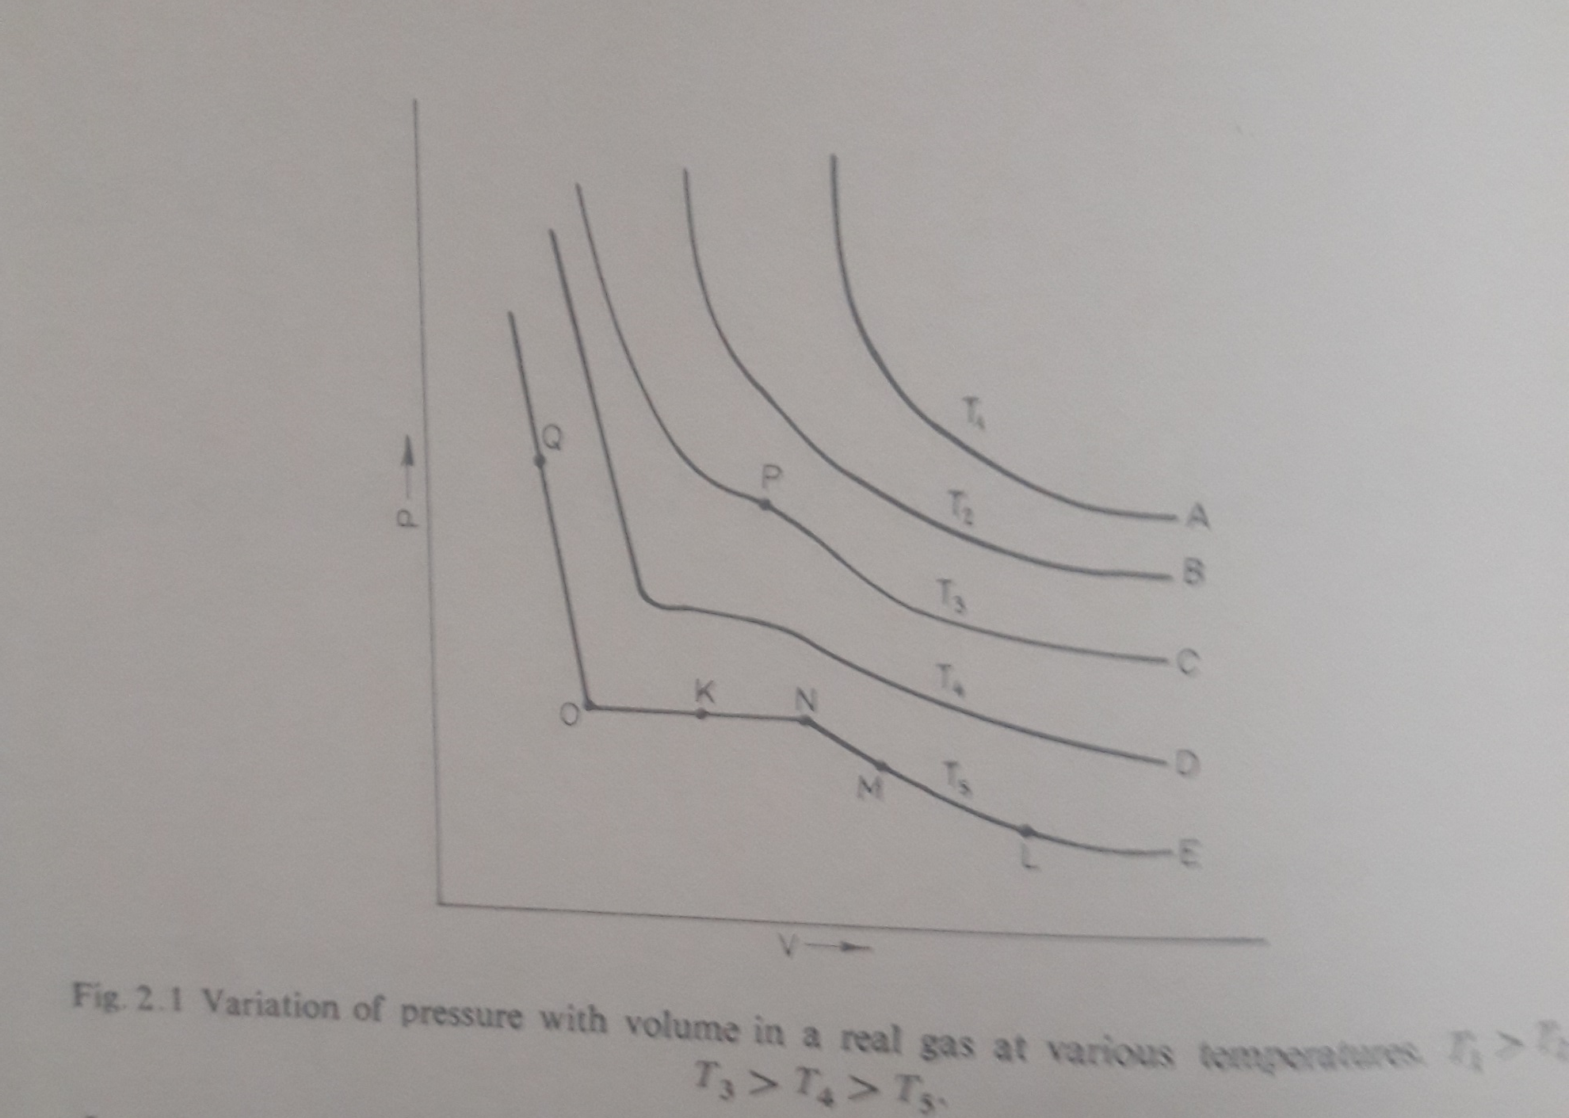

Slide 3
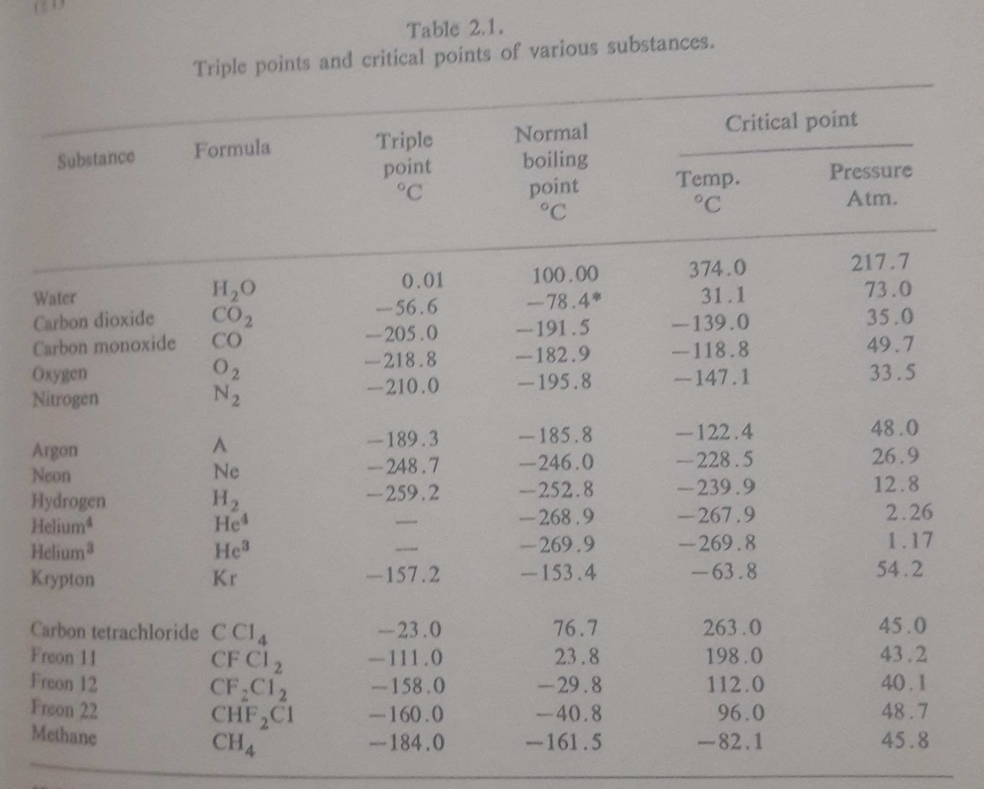

Slide 4
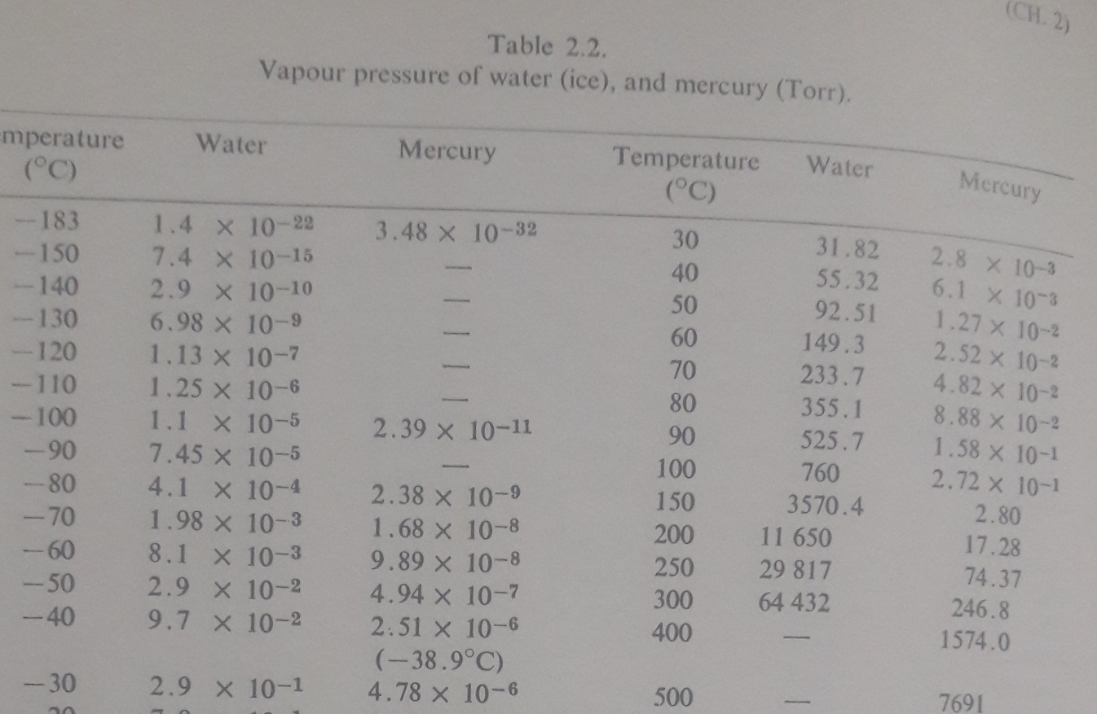

Slide 5
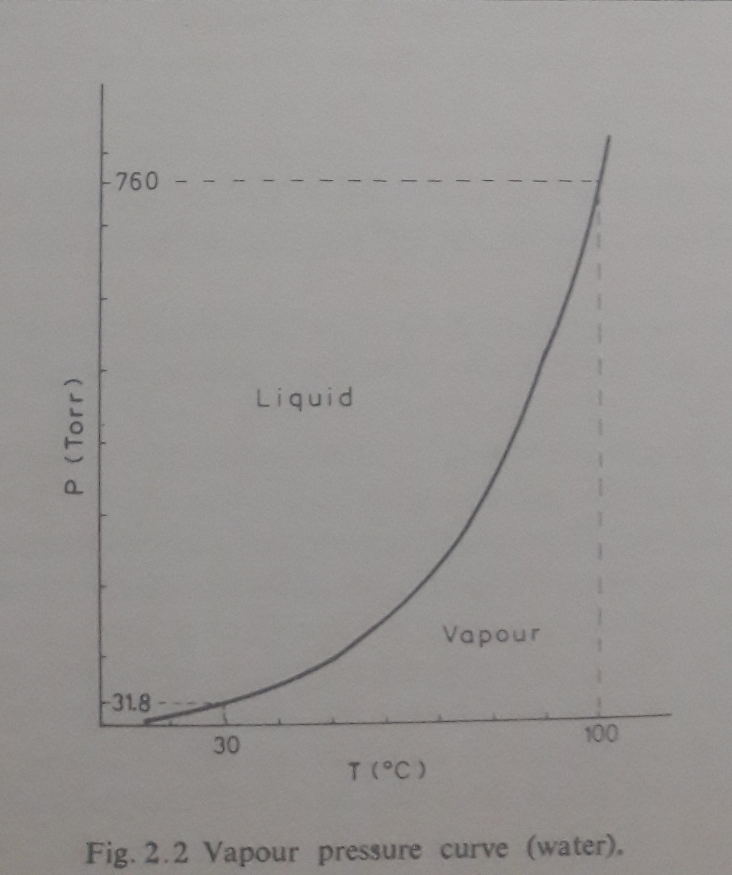

Slide 6
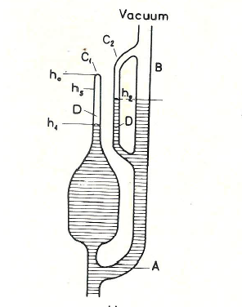
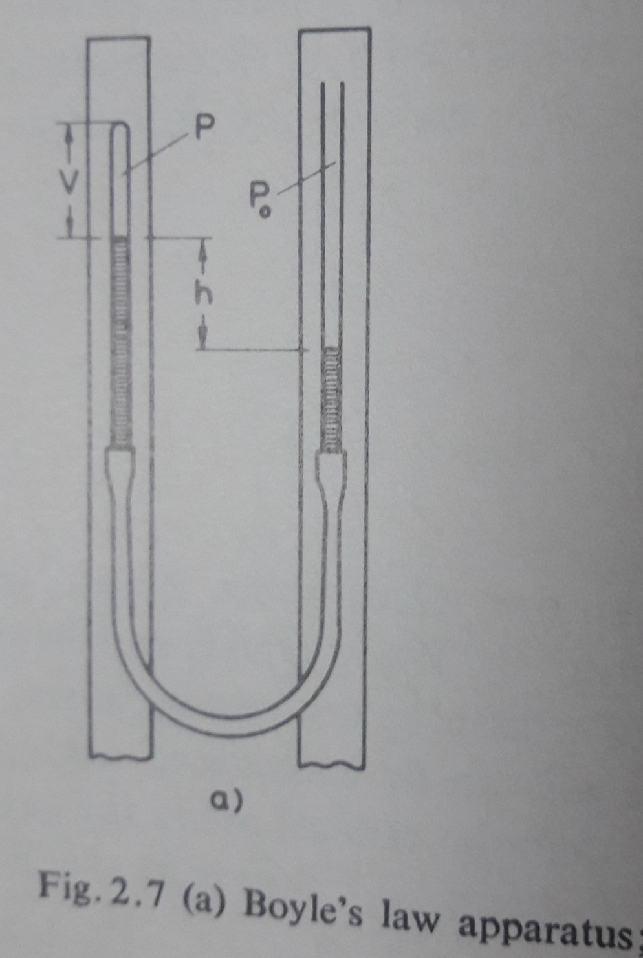

Slide 7
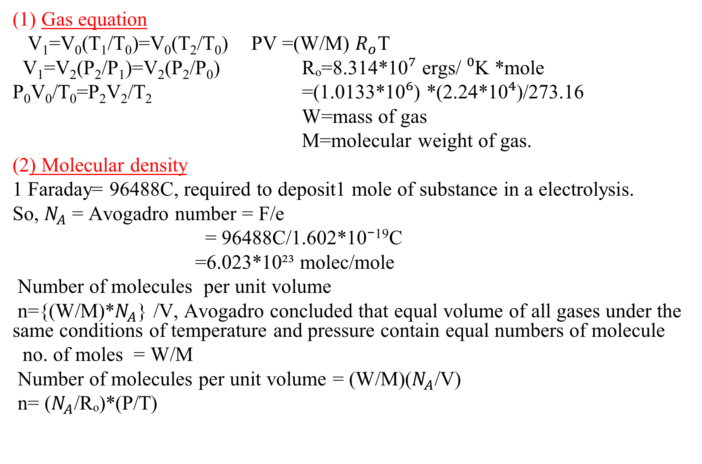
(1) Gas equation
V₁=V₀(T₁/T₀)=V₀(T₂/T₀) PV =(W/M) $R_{o}$T
V₁=V₂(P₂/P₁)=V₂(P₂/P₀) Rₒ=8.314*10⁷ ergs/ ⁰K *mole
P₀V₀/T₀=P₂V₂/T₂ =(1.0133*10⁶) *(2.24*10⁴)/273.16
W=mass of gas
M=molecular weight of gas.
(2) Molecular density
1 Faraday= 96488C, required to deposit1 mole of substance in a electrolysis.
So, $N_{A}$ = Avogadro number = F/e
= 96488C/1.602*10⁻¹⁹C
=6.023*10²³ molec/mole
Number of molecules per unit volume
n={(W/M)*$N_{A}$} /V, Avogadro concluded that equal volume of all gases under the same conditions of temperature and pressure contain equal numbers of molecule
no. of moles = W/M
Number of molecules per unit volume = (W/M)($N_{A}$/V)
n= ($N_{A}$/Rₒ)*(P/T)

Slide 8
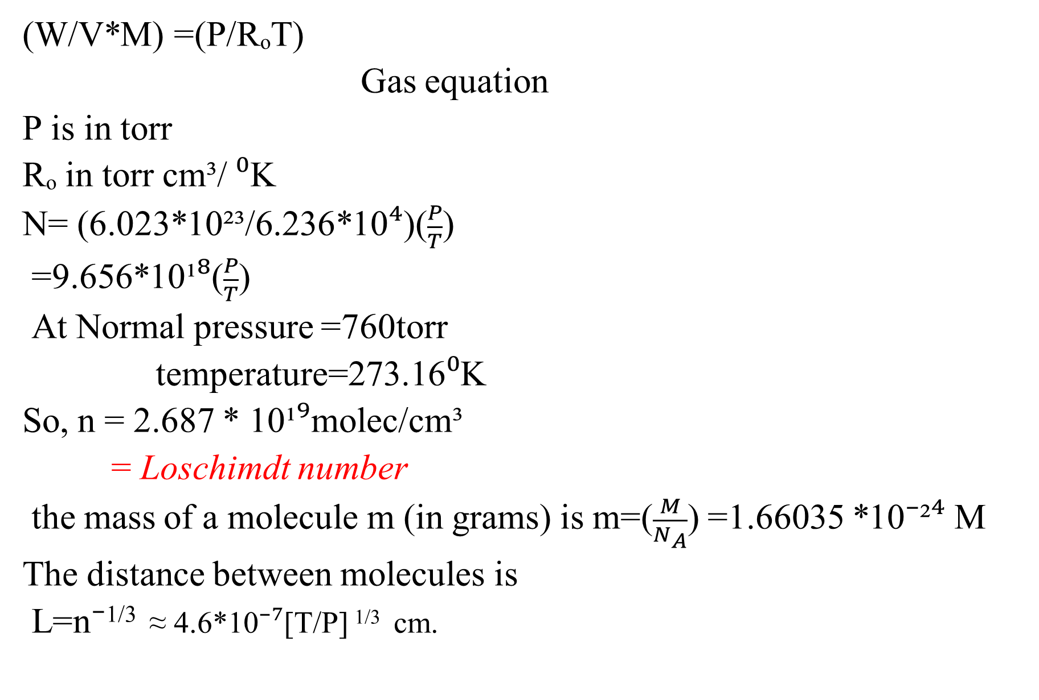
(W/V*M) =(P/RₒT)
Gas equation
P is in torr
Rₒ in torr cm³/ ⁰K
N= (6.023*10²³/6.236*10⁴)($\frac{P}{T}$)
=9.656*10¹⁸($\frac{P}{T}$)
At Normal pressure =760torr
temperature=273.16⁰K
So, n = 2.687 * 10¹⁹molec/cm³
= Loschimdt number
the mass of a molecule m (in grams) is m=($\frac{M}{N_{A}}$) =1.66035 *10⁻²⁴ M
The distance between molecules is
L=n⁻^{1/3} ≈ 4.6*10⁻⁷[T/P] ^{1/3} cm.

Slide 9
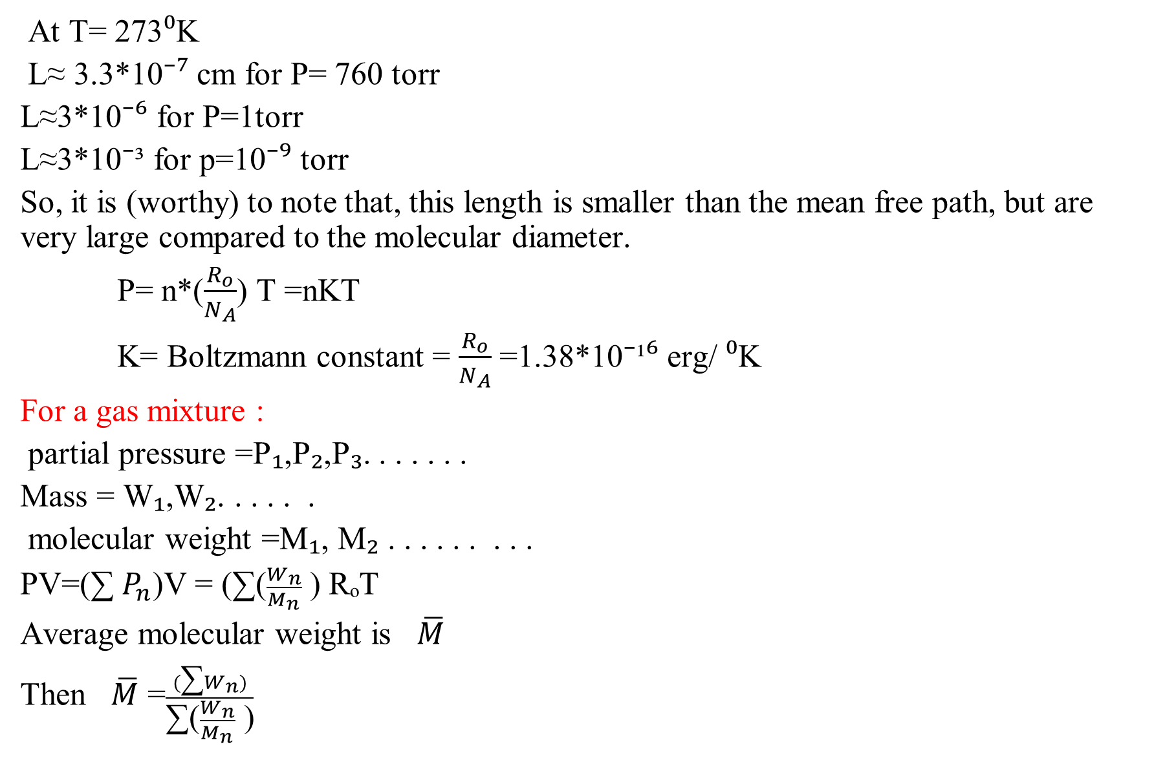
At T= 273⁰K
L≈ 3.3*10⁻⁷ cm for P= 760 torr
L≈3*10⁻⁶ for P=1torr
L≈3*10⁻³ for p=10⁻⁹ torr
So, it is (worthy) to note that, this length is smaller than the mean free path, but are very large compared to the molecular diameter.
P= n*($\frac{R_{o}}{N_{A}}$) T =nKT
K= Boltzmann constant = $\frac{R_{o}}{N_{A}}$ =1.38*10⁻¹⁶ erg/ ⁰K
For a gas mixture :
partial pressure =P₁,P₂,P₃. . . . . . .
Mass = W₁,W₂. . . . . .
molecular weight =M₁, M₂ . . . . . . . . .
PV=(∑ $P_{n}$)V = (∑($\frac{W_{n}}{M_{n}}$ ) RₒT
Average molecular weight is $\overline{M}$
Then $\overline{M}$ =$\frac{(\text{∑}W_{n})}{\text{∑(}\frac{W_{n}}{M_{n}}\text{ )}}$

Slide 10
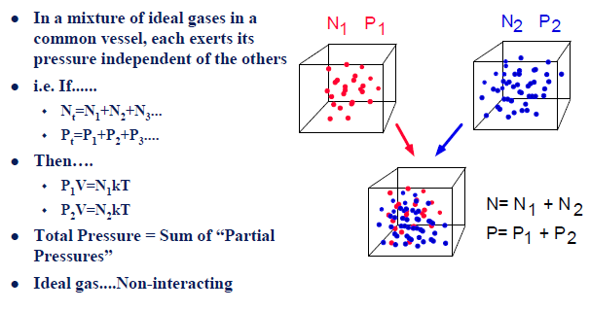

Slide 11
PREVIOUS CLASSES
1- Error analysis
2- Precession, Resolution etc.
3- Examples of different applications of Vacuum Techniques
4- Units of Pressure and its conversions
5- Basics of Gas Properties
6- Gas laws
Molecular incident rate, Mean free path and Viscosity of a gas

Slide 12
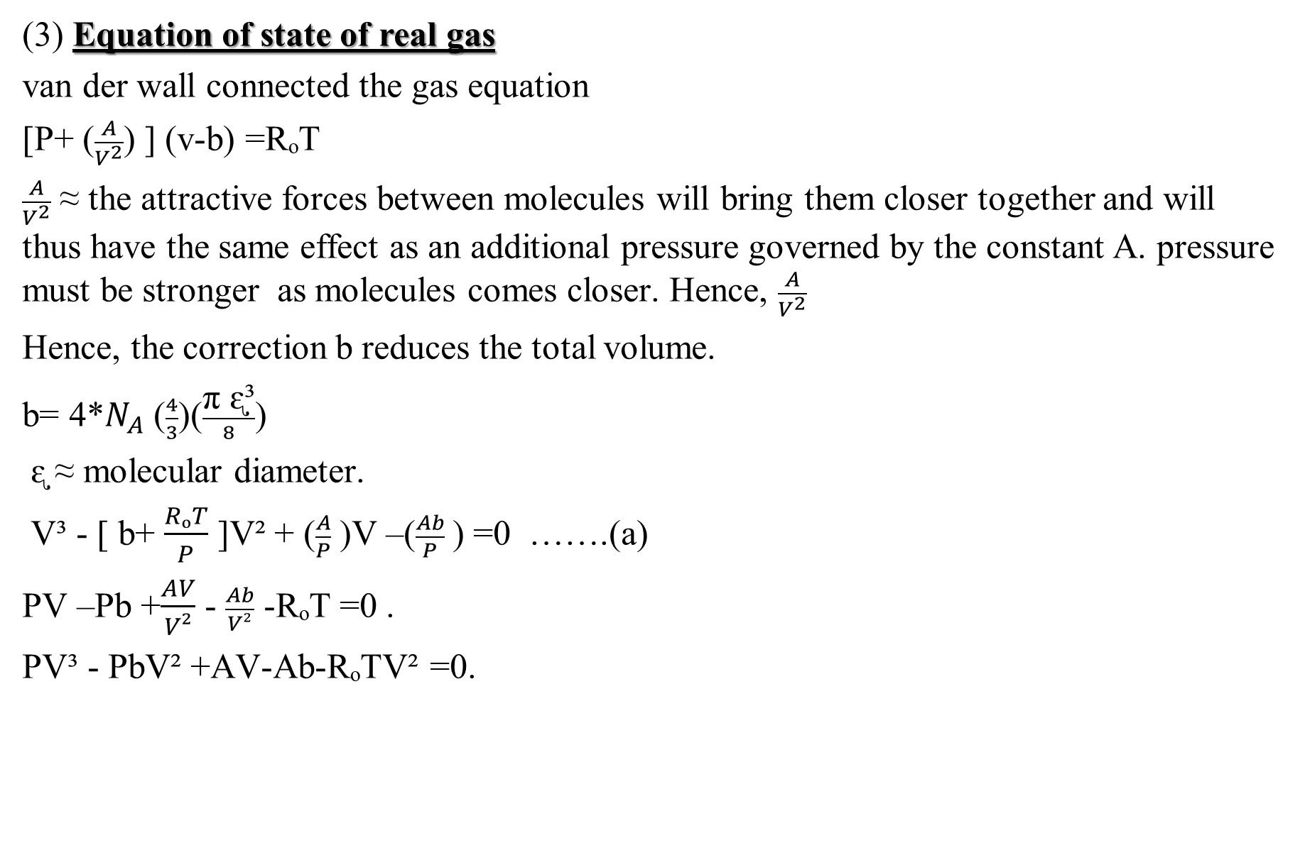
(3) Equation of state of real gas
van der wall connected the gas equation
[P+ ($\frac{A}{V^{2}}$) ] (v-b) =RₒT
$\frac{A}{V^{2}}$ ≈ the attractive forces between molecules will bring them closer together and will thus have the same effect as an additional pressure governed by the constant A. pressure must be stronger as molecules comes closer. Hence, $\frac{A}{V^{2}}$
Hence, the correction b reduces the total volume.
b= 4*$N_{A}$ ($\frac{4}{3}$)($\frac{\text{π}\text{ ᶓ}\text{³}}{8}$)
ᶓ ≈ molecular diameter.
V³ - [ b+ $\frac{RₒT}{P}$ ]V² + ($\frac{A}{P}$ )V –($\frac{Ab}{P}$) =0 …….(a)
PV –Pb +$\frac{AV}{V²}$ - $\frac{Ab}{V²}$ -RₒT =0 .
PV³ - PbV² +AV-Ab-RₒTV² =0.

Slide 13
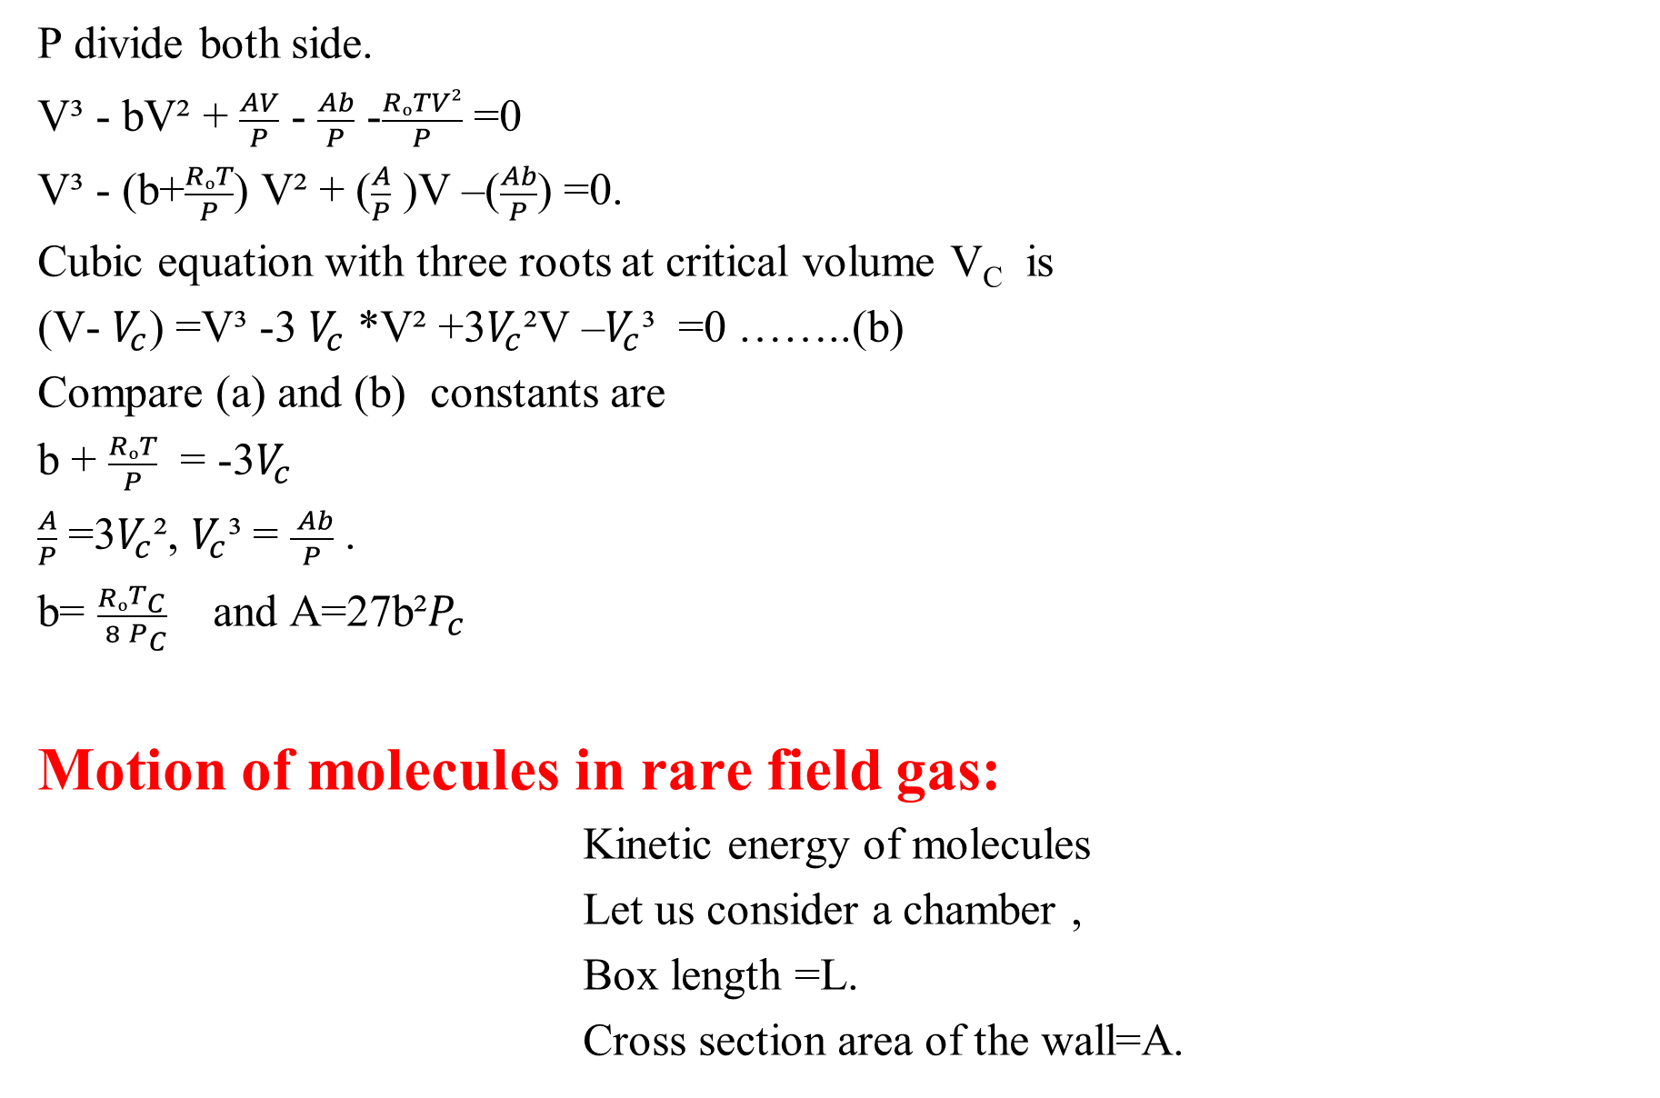
P divide both side.
V³ - bV² + $\frac{AV}{P}$ - $\frac{Ab}{P}$ -$\frac{RₒTV²}{P}$ =0
V³ - (b+$\frac{RₒT}{P}$) V² + ($\frac{A}{P}$ )V –($\frac{Ab}{P}$) =0.
Cubic equation with three roots at critical volume V_{C} is
(V- $V_{c}$) =V³ -3 $V_{c}$ *V² +3$V_{c}$²V –$V_{c}$³ =0 ……..(b)
Compare (a) and (b) constants are
b + $\frac{RₒT}{P}$ = -3$V_{c}$
$\frac{A}{P}$ =3$V_{c}$², $V_{c}$³ = $\frac{ Ab}{P}$ .
b= $\frac{Rₒ}{8}\frac{T_{C}}{P_{C}}$ and A=27b²$P_{c}$
Motion of molecules in rare field gas:
Kinetic energy of molecules
Let us consider a chamber ,
Box length =L.
Cross section area of the wall=A.

Slide 14
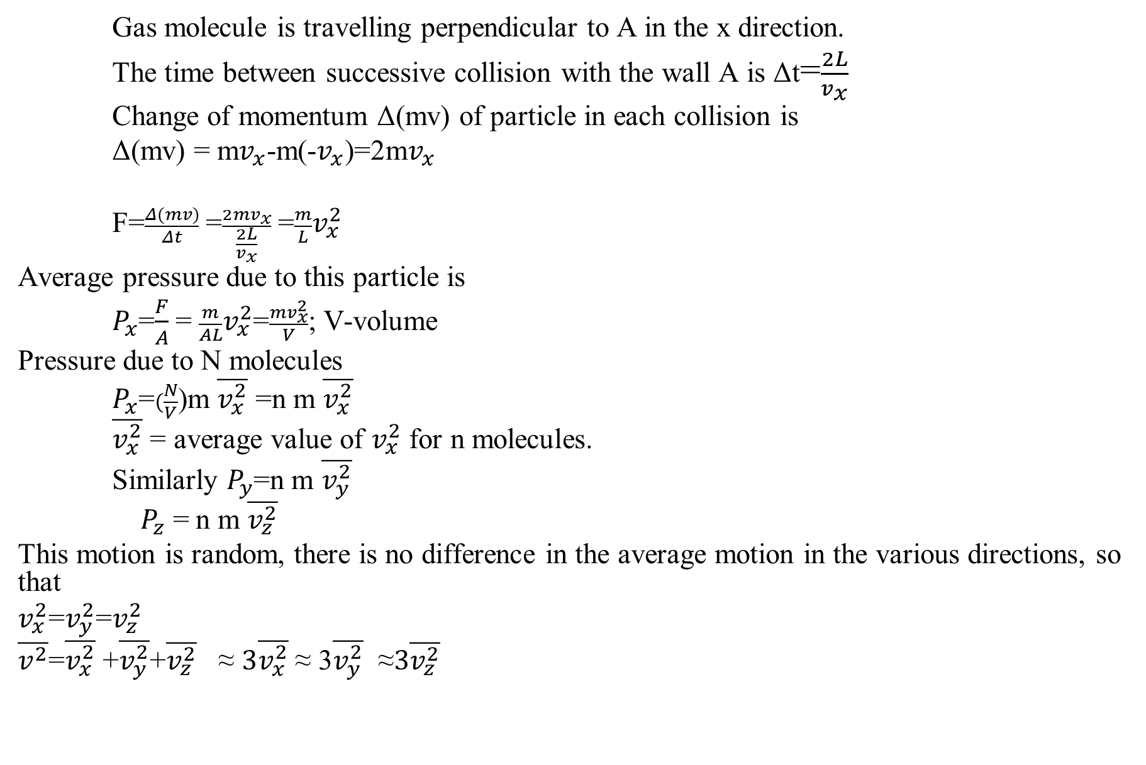
Gas molecule is travelling perpendicular to A in the x direction.
The time between successive collision with the wall A is Δt=$\frac{2L}{v_{x}}$
Change of momentum Δ(mv) of particle in each collision is
Δ(mv) = m$v_{x}$-m(-$v_{x}$)=2m$v_{x}$
F=$\frac{Δ(mv)}{Δt}$ =$\frac{2mv_{x}}{\frac{2L}{v_{x}}}$ =$\frac{m}{L}v_{x}^{2}$
Average pressure due to this particle is
$P_{x}$=$\frac{F}{A}$ = $\frac{m}{AL}v_{x}^{2}$=$\frac{mv_{x}^{2}}{V}$; V-volume
Pressure due to N molecules
$P_{x}$=$(\frac{N}{V}$)m $\overline{v_{x}^{2}}$ =n m $\overline{v_{x}^{2}}$
$\overline{v_{x}^{2}}$ = average value of $v_{x}^{2}$ for n molecules.
Similarly $P_{y}$=n m $\overline{v_{y}^{2}}$
$P_{z}$ = n m $\overline{v_{z}^{2}}$
This motion is random, there is no difference in the average motion in the various directions, so that
$v_{x}^{2}$=$v_{y}^{2}$=$v_{z}^{2}$
$\overline{v^{2}}$=$\overline{v_{x}^{2}}$ +$\overline{v_{y}^{2}}$+$\overline{v_{z}^{2}}$ ≈ $3\overline{v_{x}^{2}}$ ≈ 3$\overline{v_{y}^{2}}$ ≈$3\overline{v_{z}^{2}}$

Slide 15
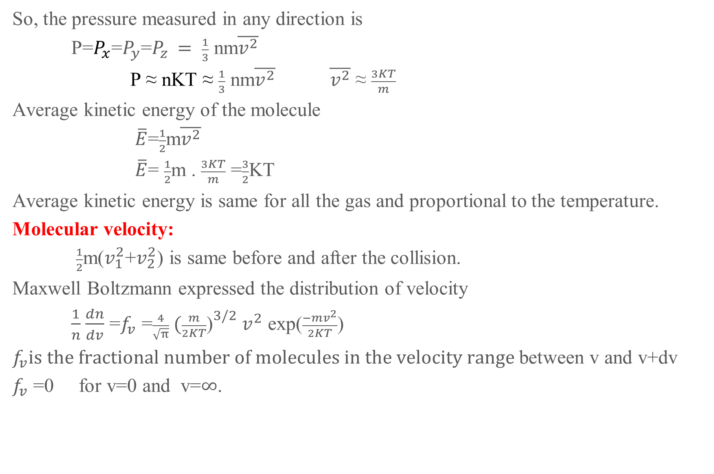
So, the pressure measured in any direction is
P=$P_{x}$=$P_{y}$=$P_{z }= \frac{1}{3}$ nm$\overline{v^{2}}$
P ≈ nKT ≈ $\frac{1}{3}$ nm$\overline{v^{2}}$ $\overline{v^{2}}$ ≈ $\frac{3KT}{m}$
Average kinetic energy of the molecule
$\overline{E}$=$\frac{1}{2}$m$\overline{v^{2}}$
$\overline{E}$= $\frac{1}{2}$m . $\frac{3KT}{m}$ =$\frac{3}{2}$KT
Average kinetic energy is same for all the gas and proportional to the temperature.
Molecular velocity:
$\frac{1}{2}$m($v_{1}^{2}$+$v_{2}^{2}$) is same before and after the collision.
Maxwell Boltzmann expressed the distribution of velocity
$\frac{1}{n}$ $\frac{dn}{dv}$ =$f_{v}$ =$\frac{4}{\sqrt{π}} {(\frac{m}{2KT}\text{)}}^{3/2}$ $v^{2}$ exp($\frac{−mv^{2}}{2KT}$)
$f_{v}is the fractional number of molecules in the velocity range$ between v and v+dv
$f_{v}$ =0 for v=0 and v=$∞$.

Slide 16
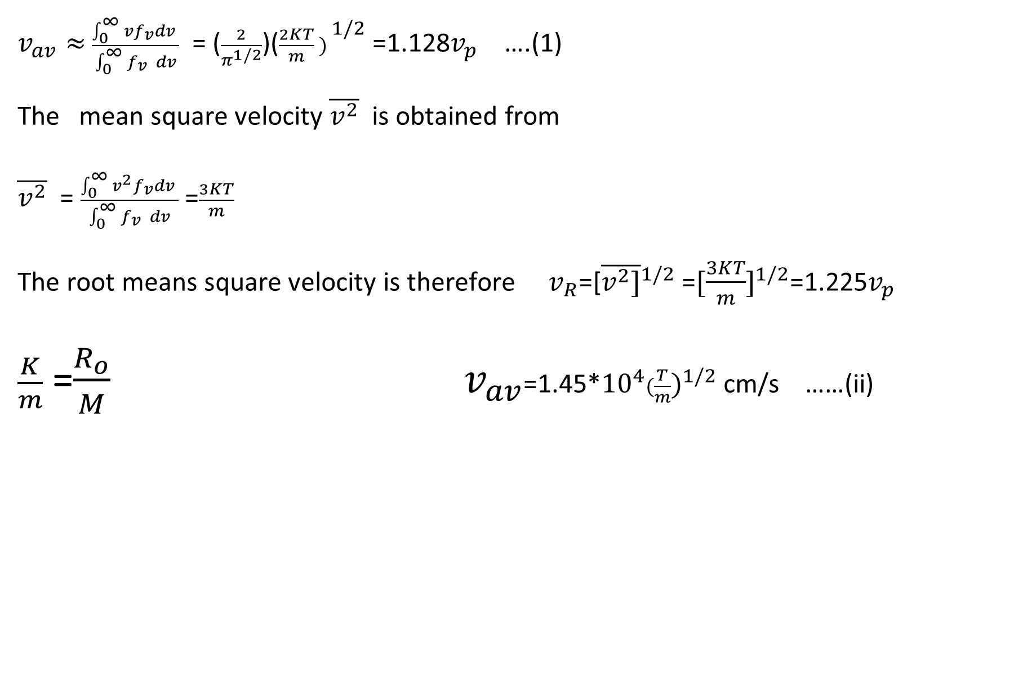
$v_{av}≈$ $\frac{\int_{0 }^{∞}{{vf}_{v}dv} }{\int_{0 }^{∞}{f_{v }}dv}$ = ($\frac{2}{π^{1/2}}$)(${\frac{2KT}{m} ) }^{1/2}$ =1.128$v_{p}$ ….(1)
The mean square velocity $\overline{v^{2}}$ is obtained from
$\overline{v^{2}}$ = $\frac{\int_{0 }^{∞}{{v^{2}f}_{v}dv} }{\int_{0 }^{∞}{f_{v }}dv}$ =$\frac{3KT}{m}$
The root means square velocity is therefore $v_{R}$=[${\overline{v^{2}]}}^{1/2}$ =$[{\frac{3KT}{m}]}^{1/2}$=1.225$v_{p}$
$\frac{K}{m}$ =$\frac{R_{o}}{M}$ $v_{av}$=1.45*${10}^{4}{(\frac{T}{m})}^{1/2}$ cm/s ……(ii)

Slide 17
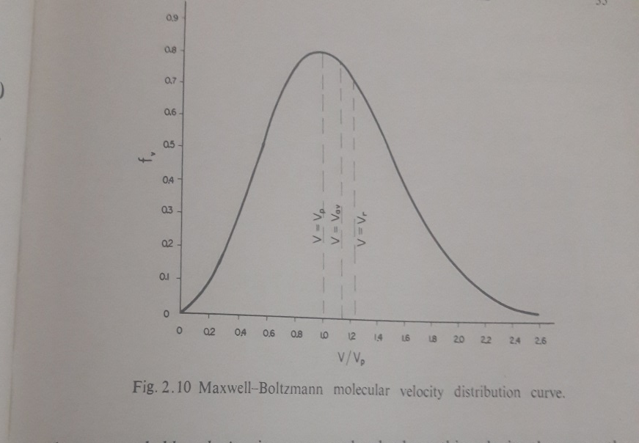

Slide 18

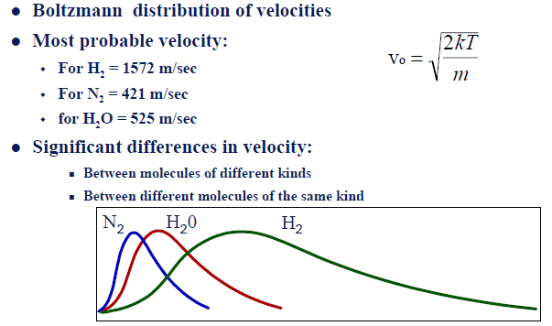

Slide 19
PREVIOUS CLASSES
1- Error analysis
2- Precession, Resolution etc.
3- Examples of different applications of Vacuum Techniques
4- Basics of Gas Properties
5- Gas laws
6- Velocity of gasses etc.
Molecular incident rate, Mean free path and Viscosity of a gas

Slide 20
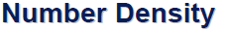
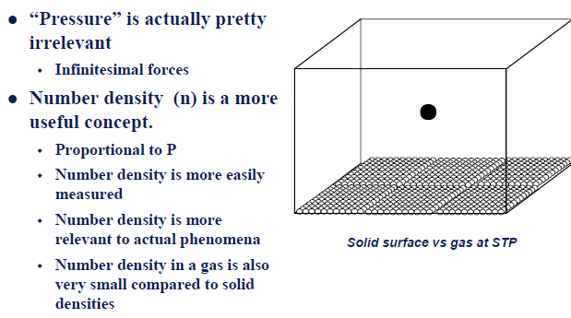

Slide 21
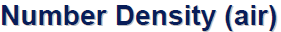
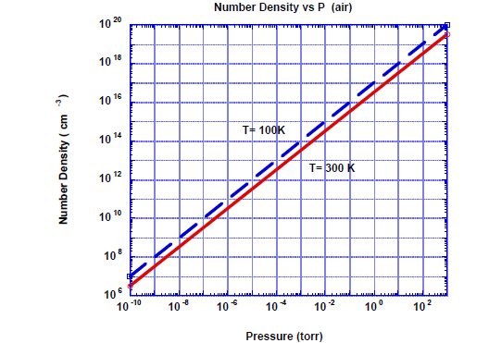

Slide 22
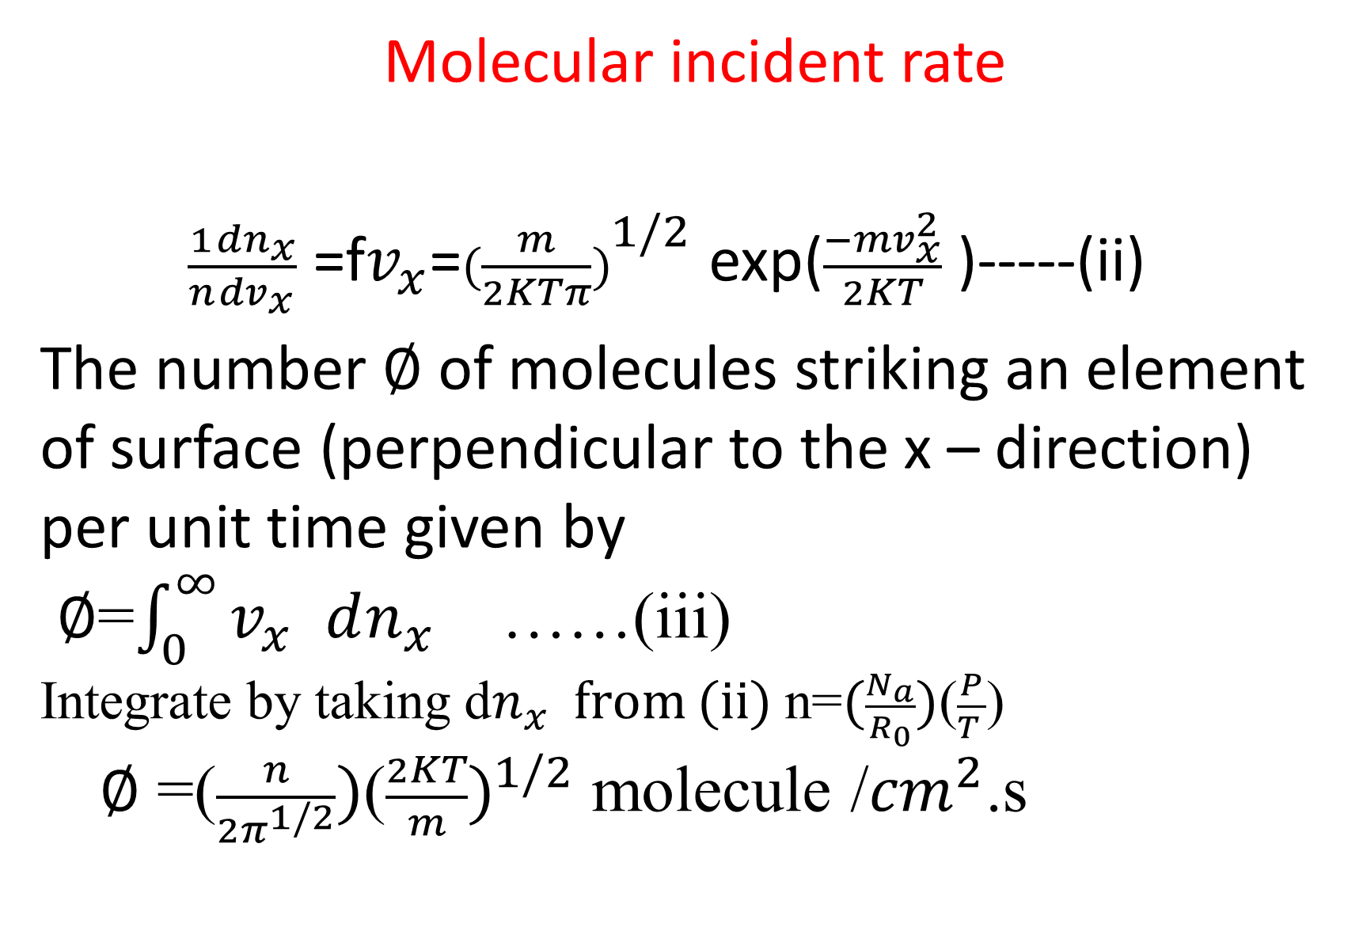
Molecular incident rate
$\frac{1}{n}\frac{dn_{x}}{dv_{x}}$ =f$v_{x}$=${(\frac{m}{2KTπ})}^{1/2}$ exp($\frac{−mv_{x}^{2}}{2KT}$ )-----(ii)
The number $∅$ of molecules striking an element of surface (perpendicular to the x – direction) per unit time given by
$∅$=$\int_{0}^{∞}{v_{x }dn_{x}}$ ……(iii)
Integrate by taking d$n_{x}$from (ii) n=$(\frac{N_{a}}{R_{0}})$($\frac{P}{T }$)
$∅$ =($\frac{n}{2π^{1/2}})$(${\frac{2KT}{m})}^{1/2}$ molecule /${cm}^{2}$.s
Maxwell Boltzmann expressed the distribution of velocity

Slide 23
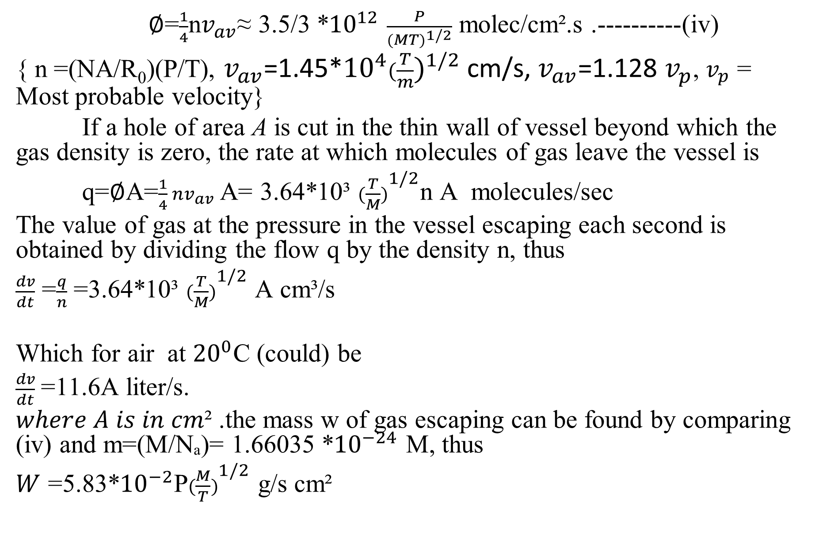
$∅$=$\frac{1}{4}$n$v_{av}$≈ 3.5/3 *${10}^{12}$ $\frac{P}{({MT)}^{1/2}}$ molec/cm².s .----------(iv)
{ n =(NA/R₀)(P/T), $v_{av}$=1.45*${10}^{4}{(\frac{T}{m})}^{1/2}$ cm/s, $v_{av}$=1.128 $v_{p}$, $v_{p}$ = Most probable velocity}
If a hole of area A is cut in the thin wall of vessel beyond which the gas density is zero, the rate at which molecules of gas leave the vessel is
q=$∅$A=$\frac{1}{4} nv_{av}$A= 3.64*10³ ${(\frac{T}{M})}^{1/2}$n A molecules/sec
The value of gas at the pressure in the vessel escaping each second is obtained by dividing the flow q by the density n, thus
$\frac{dv}{dt}$ =$\frac{q}{n}$ =3.64*10³ ${(\frac{T}{M})}^{1/2}$ A cm³/s
Which for air at ${20}^{0}$C (could) be
$\frac{dv}{dt}$=11.6A liter/s.
$where A is in cm$² .the mass w of gas escaping can be found by comparing (iv) and m=(M/Nₐ)= 1.66035 *${10}^{−24}$ M, thus
$W$ =5.83*${10}^{−2}$P${(\frac{M}{T})}^{1/2}$ g/s cm²

Slide 24
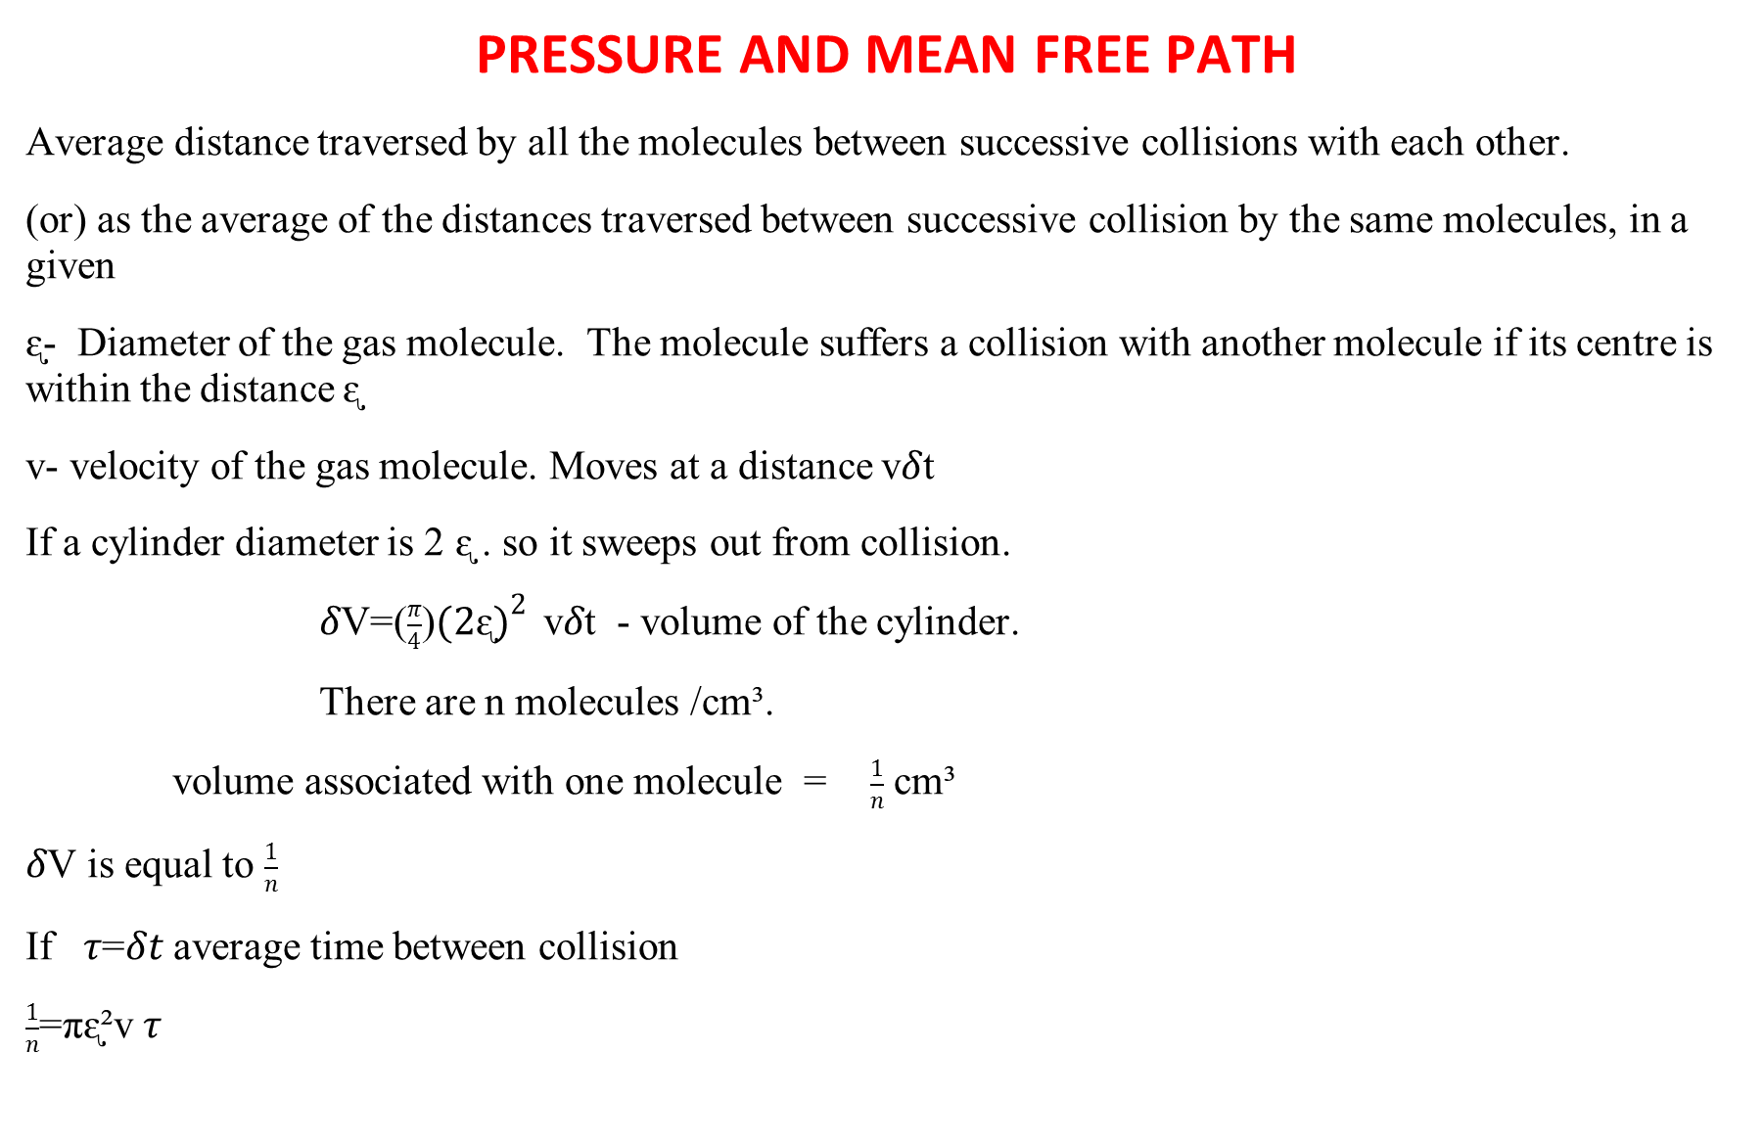
PRESSURE AND MEAN FREE PATH
Average distance traversed by all the molecules between successive collisions with each other.
(or) as the average of the distances traversed between successive collision by the same molecules, in a given
ᶓ- Diameter of the gas molecule. The molecule suffers a collision with another molecule if its centre is within the distance ᶓ
v- velocity of the gas molecule. Moves at a distance v𝛿t
If a cylinder diameter is 2 ᶓ . so it sweeps out from collision.
$δ$V=($\frac{π}{4}$)${(2ᶓ)}^{2 }$ v$δ$t - volume of the cylinder.
There are n molecules /cm³.
volume associated with one molecule = $\frac{1}{n}$ cm³
$δ$V is equal to $\frac{1}{n}$
If $τ$=$δt$ average time between collision
$\frac{1}{n}$=πᶓ²v $τ$

Slide 25
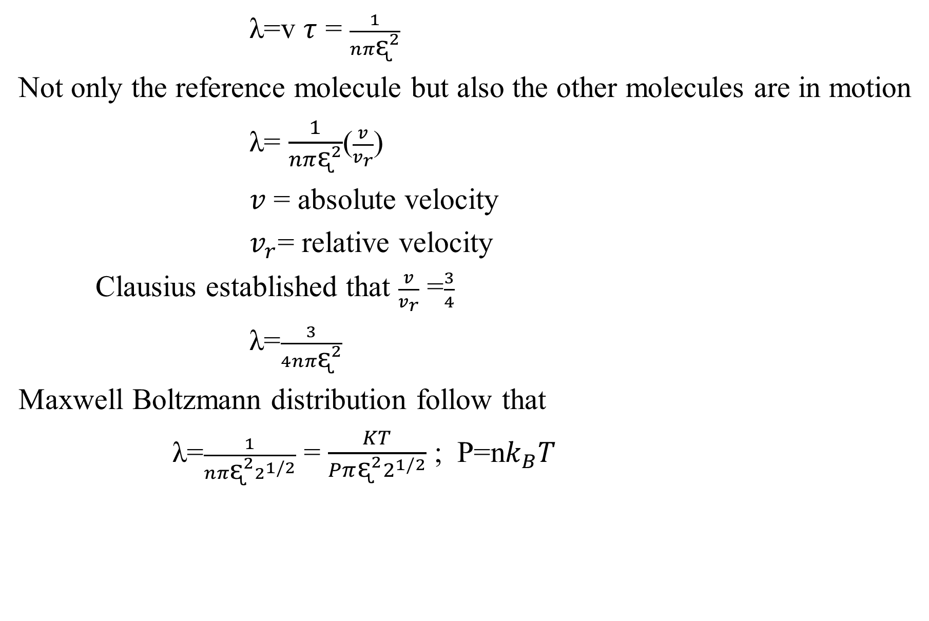
λ=v $τ$ = $\frac{1}{nπᶓ^{2}}$
Not only the reference molecule but also the other molecules are in motion
λ= $\frac{1}{nπᶓ^{2}}$($\frac{v}{v_{r}}$)
𝑣 = absolute velocity
$v_{r}$= relative velocity
Clausius established that $\frac{v}{v_{r}}$ =$\frac{3}{4}$
λ=$\frac{3}{4nπᶓ^{2}}$
Maxwell Boltzmann distribution follow that
λ=$\frac{1}{{nπᶓ^{2}2}^{1/2}}$ = $\frac{KT}{{Pπᶓ^{2}2}^{1/2}}$ ; P=n$k_{B}T$

Slide 26
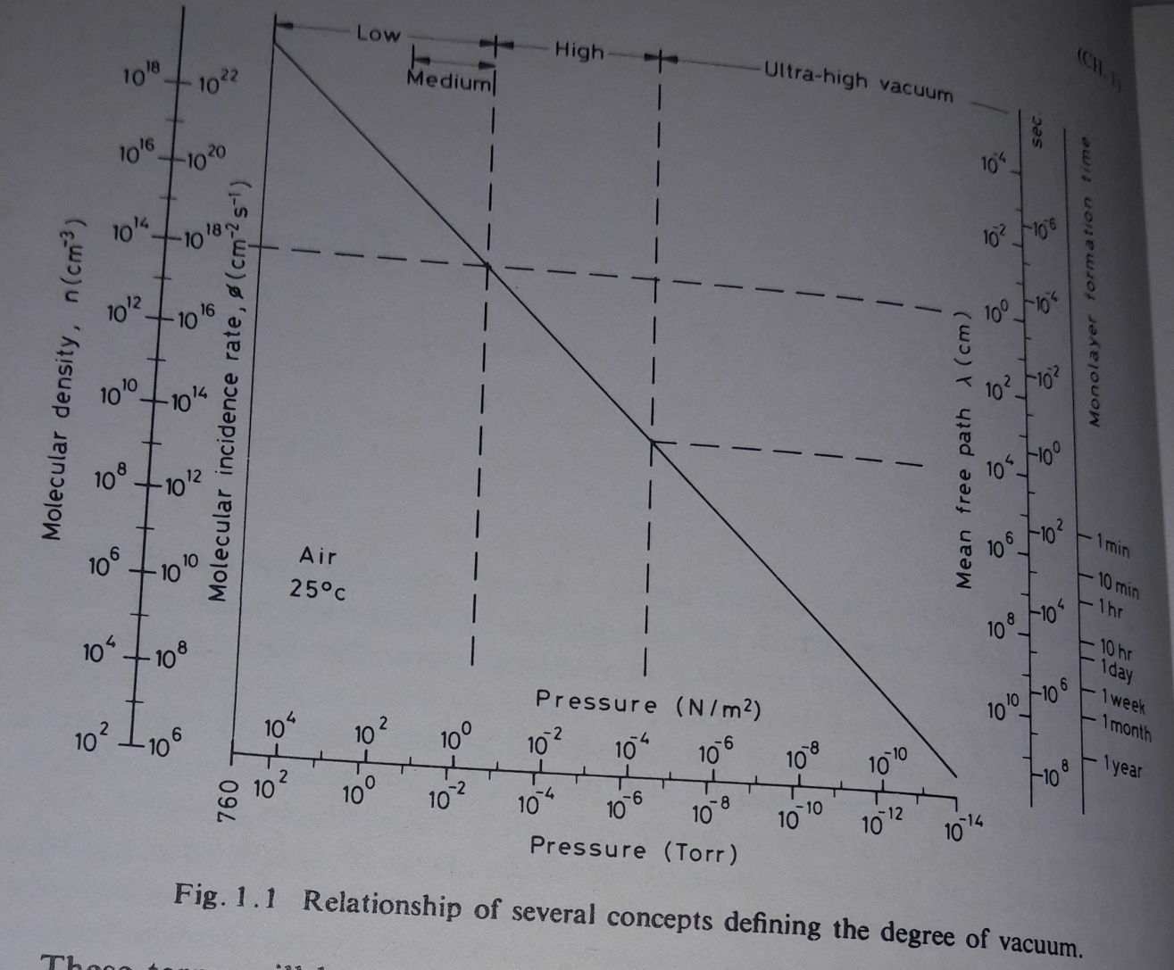
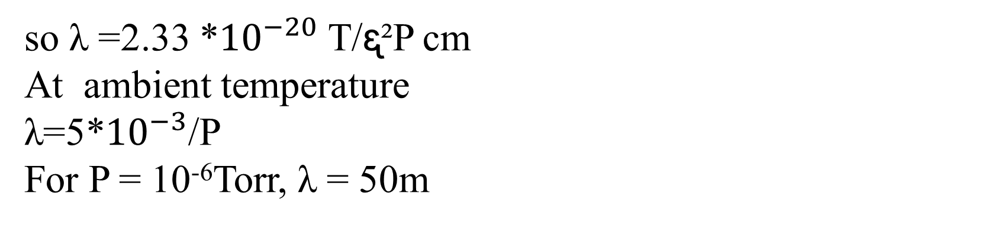
so λ =2.33 *${10}^{−20}$ T/ᶓ²P cm
At ambient temperature
λ=5*${10}^{−3}$/P
For P = 10⁻⁶Torr, λ = 50m

Slide 27
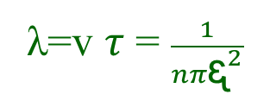
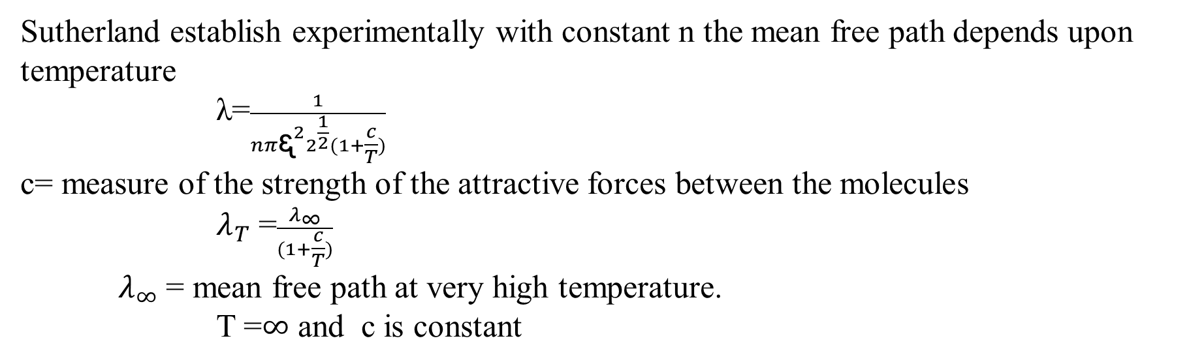
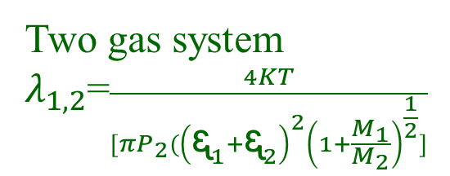
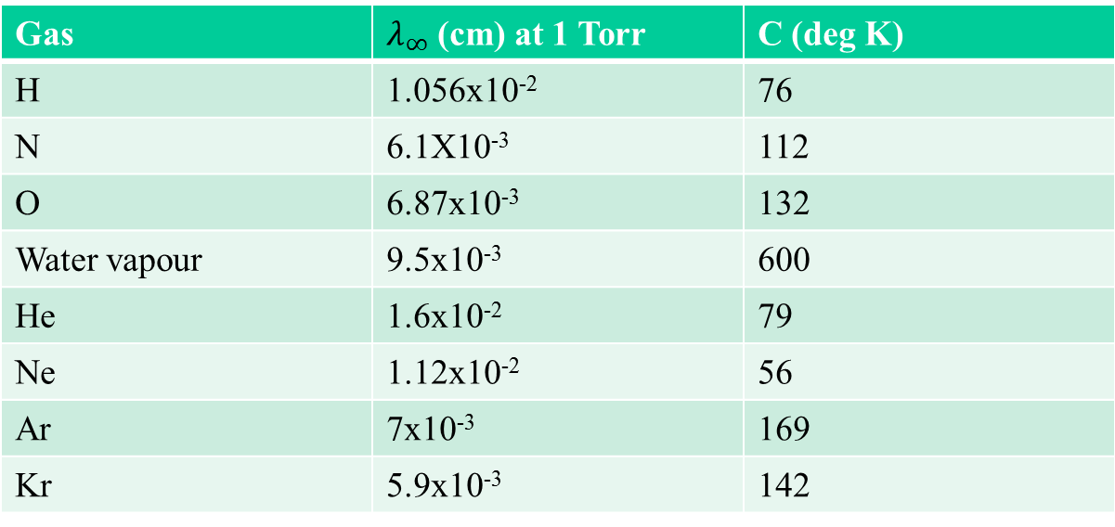
λ=v $τ$ = $\frac{1}{nπᶓ^{2}}$
The equation reveals that the mean free path does not depend upon the temperature
Sutherland establish experimentally with constant n the mean free path depends upon temperature
λ=$\frac{1}{{nπᶓ^{2}2}^{\frac{1}{2}}(1+\frac{c}{T})}$
c= measure of the strength of the attractive forces between the molecules
$λ_{T}$ =$\frac{λ_{∞}}{(1+\frac{c}{T})}$
$λ_{∞}$ = mean free path at very high temperature.
T =$∞$ and c is constant
Gas | $λ_{∞}$ (cm) at 1 Torr | C (deg K)
H | 1.056x10⁻² | 76
N | 6.1X10⁻³ | 112
O | 6.87x10⁻³ | 132
Water vapour | 9.5x10⁻³ | 600
He | 1.6x10⁻² | 79
Ne | 1.12x10⁻² | 56
Ar | 7x10⁻³ | 169
Kr | 5.9x10⁻³ | 142
Two gas system
$λ_{1,2}$=$\frac{4KT}{[πP_{2}({\left(ᶓ_{1}{+ᶓ}_{2}\right)}^{2}{\left(1+\frac{M_{1}}{M_{2}}\right)}^{\frac{1}{2}}]}$
If 1 = 2, leads to original equation

Slide 28
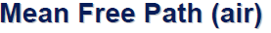
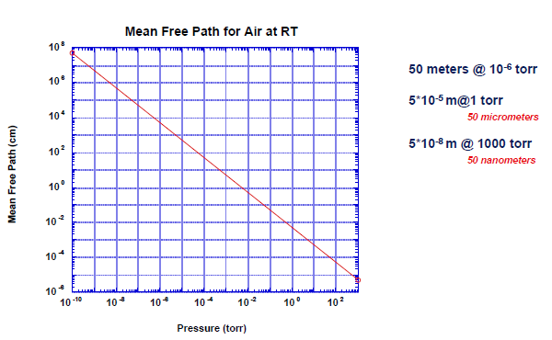

Slide 29
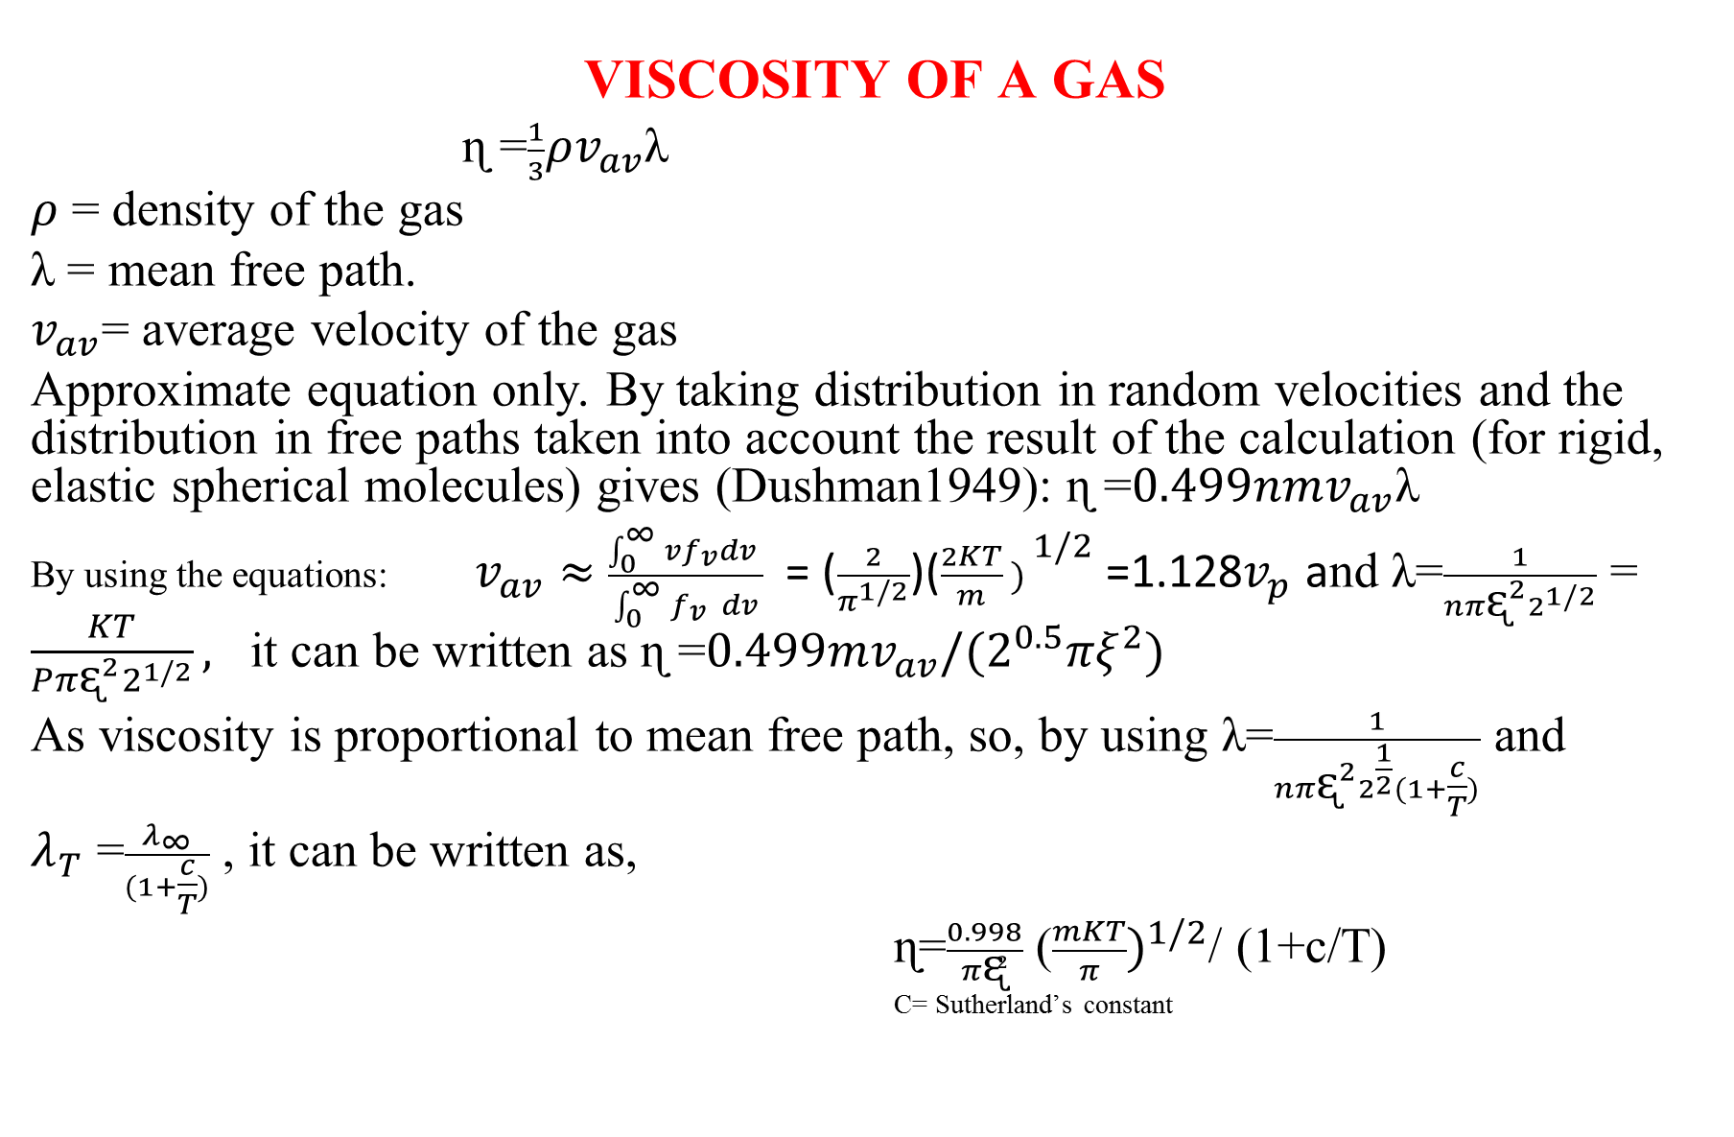
VISCOSITY OF A GAS
ɳ =$\frac{1}{3}ρv_{av}$λ
$ρ$ = density of the gas
λ = mean free path.
$v_{av}$= average velocity of the gas
Approximate equation only. By taking distribution in random velocities and the distribution in free paths taken into account the result of the calculation (for rigid, elastic spherical molecules) gives (Dushman1949): ɳ =$0.499nmv_{av}$λ
By using the equations: $v_{av}≈$ $\frac{\int_{0 }^{∞}{{vf}_{v}dv} }{\int_{0 }^{∞}{f_{v }}dv}$ = ($\frac{2}{π^{1/2}}$)(${\frac{2KT}{m} ) }^{1/2}$ =1.128$v_{p}$ and λ=$\frac{1}{{nπᶓ^{2}2}^{1/2}}$ = $\frac{KT}{{Pπᶓ^{2}2}^{1/2}},$ it can be written as ɳ =$0.499mv_{av}/{(2}^{0.5}πξ^{2})$
As viscosity is proportional to mean free path, so, by using λ=$\frac{1}{{nπᶓ^{2}2}^{\frac{1}{2}}(1+\frac{c}{T})}$ and
$λ_{T}$ =$\frac{λ_{∞}}{(1+\frac{c}{T})}$ , it can be written as,
ɳ=$\frac{0.998}{πᶓ²}$ (${\frac{mKT}{π})}^{1/2}$/ (1+c/T)
C= Sutherland’s constant

Slide 30
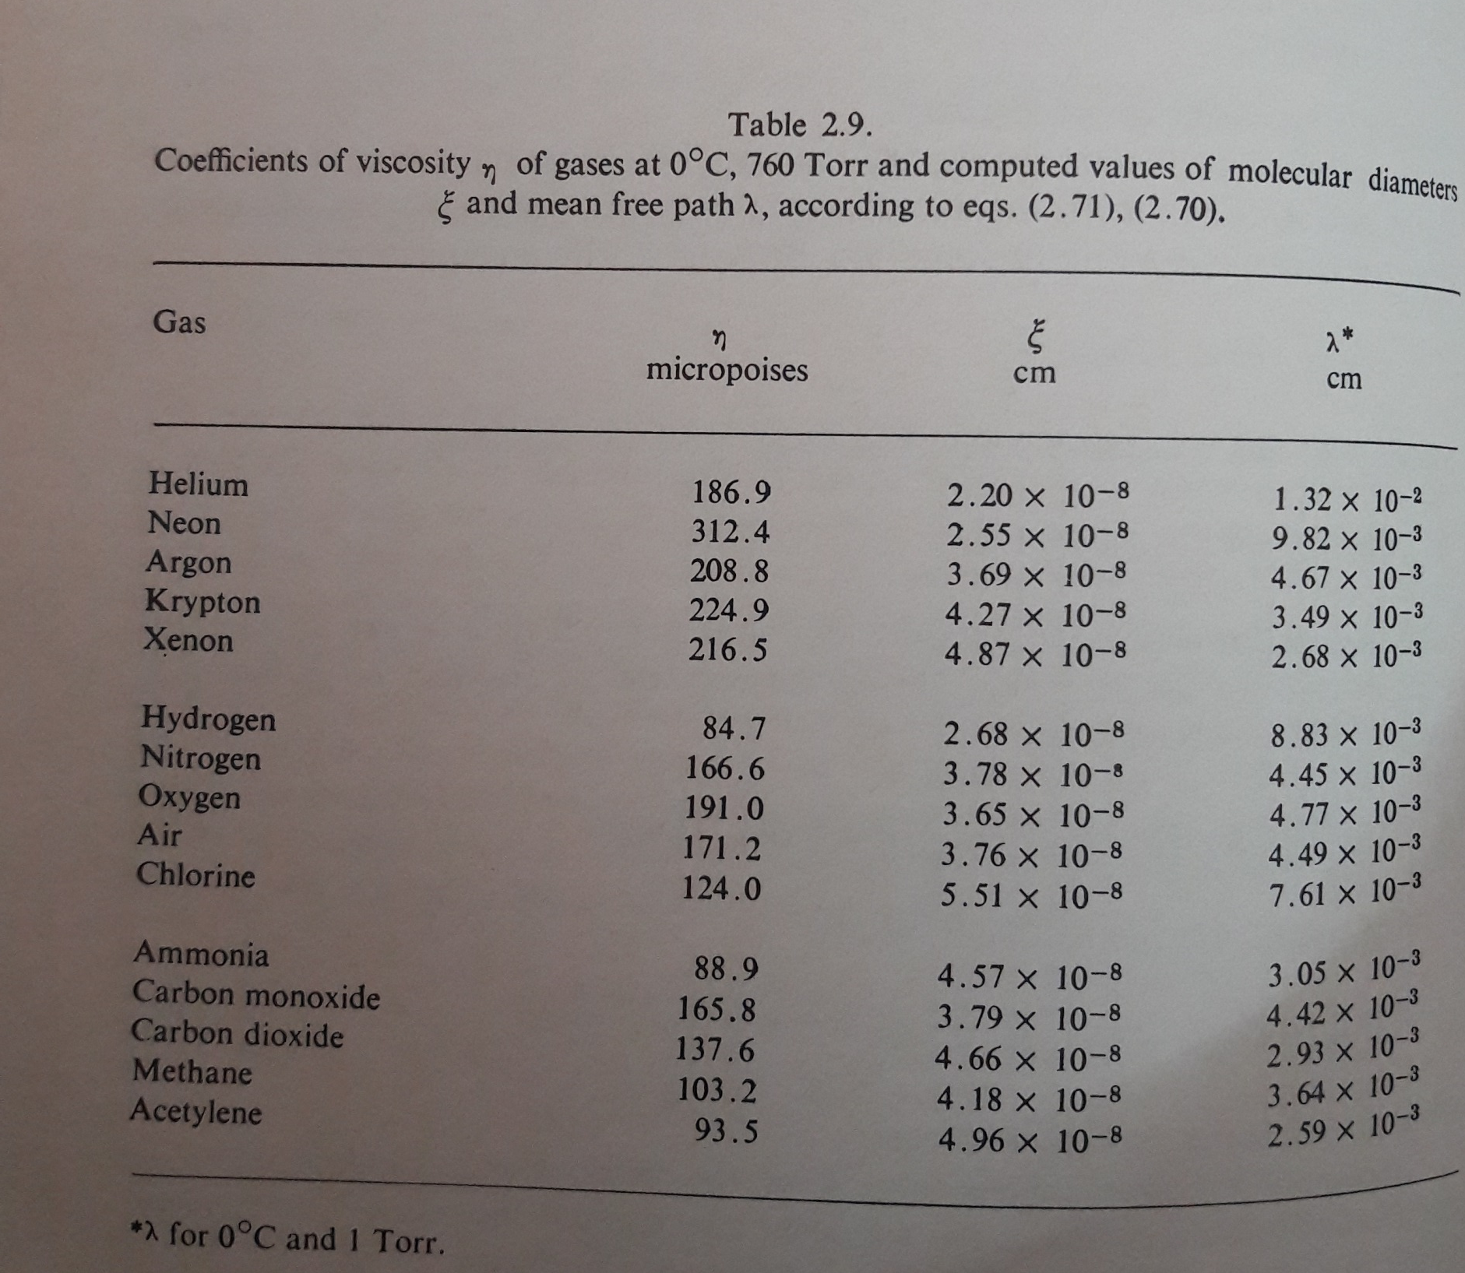
1Poise = 1g.cm⁻¹.s⁻¹

Slide 31
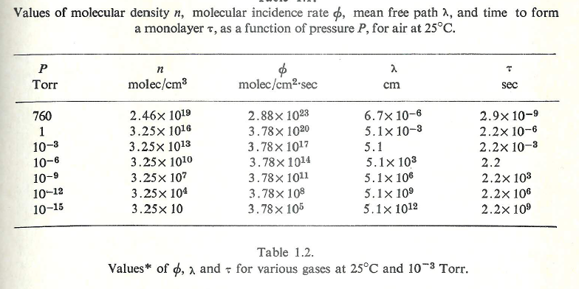

Slide 32
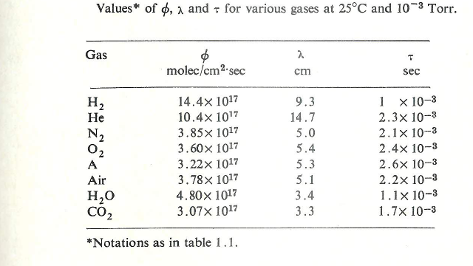

Slide 33
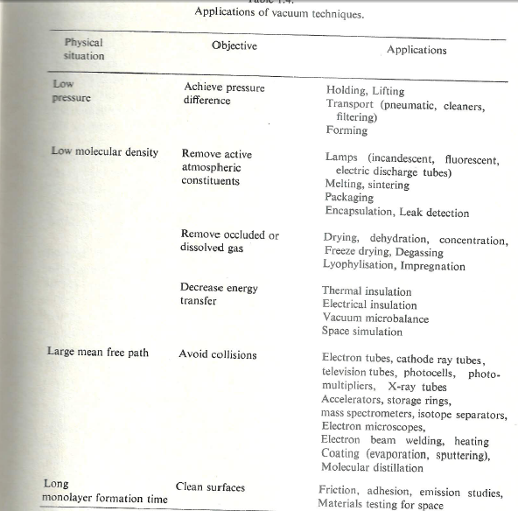

Slide 34
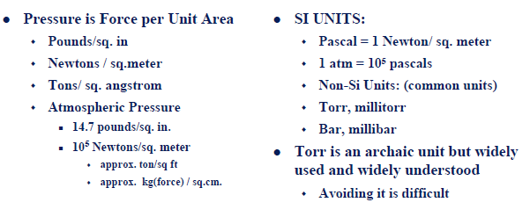
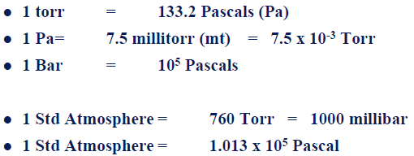
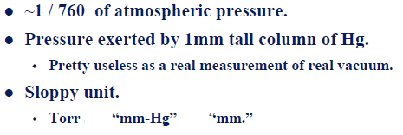
Units of Pressure
Pressure Unit conversion
Torr

Slide 35
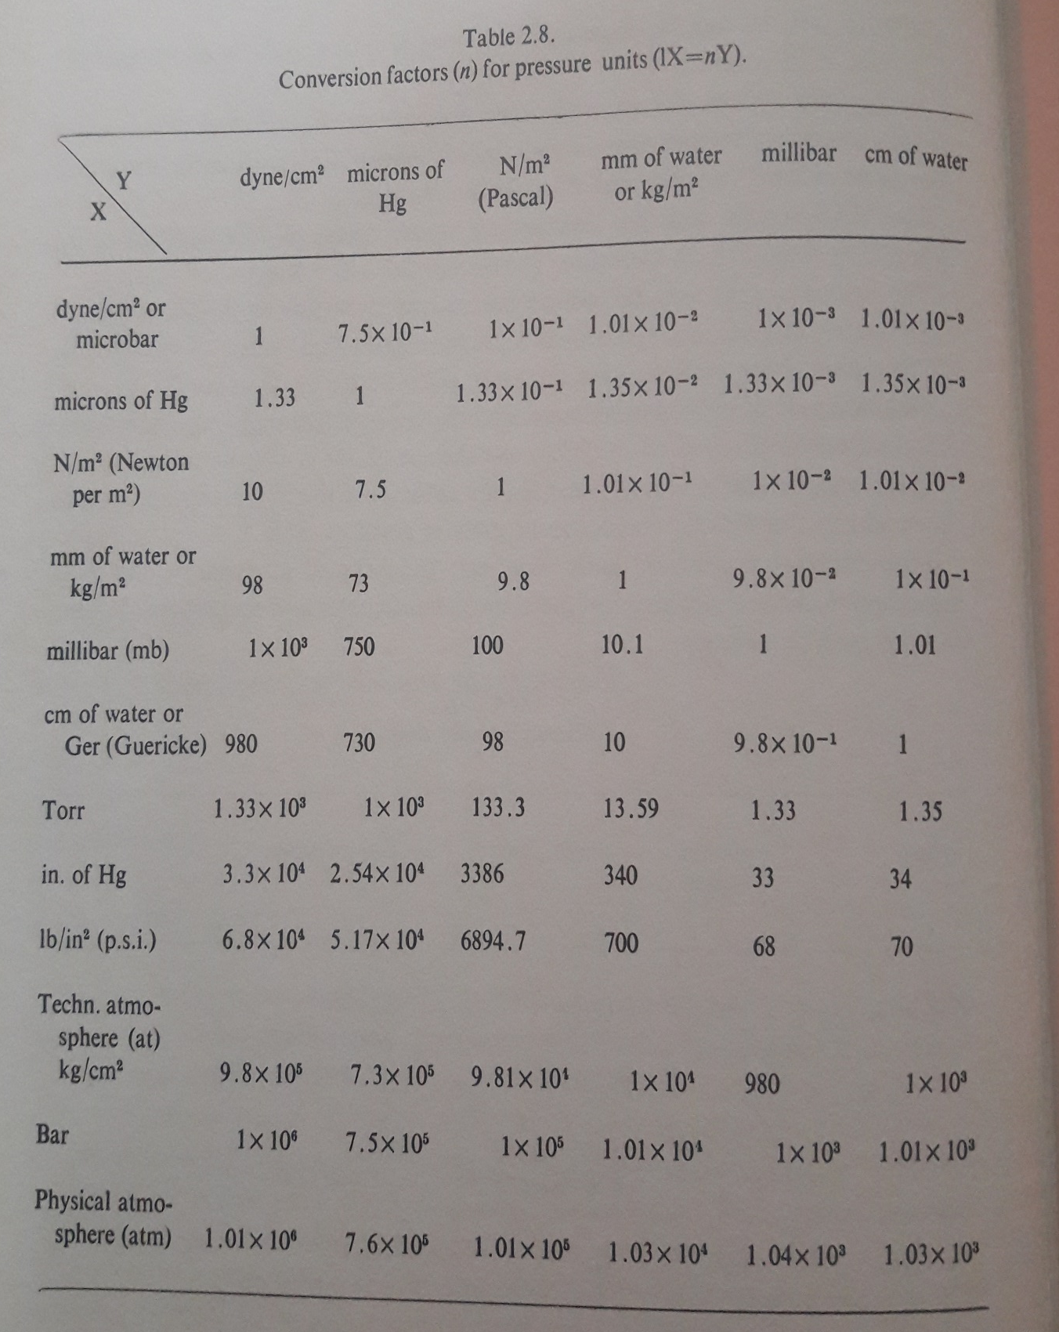
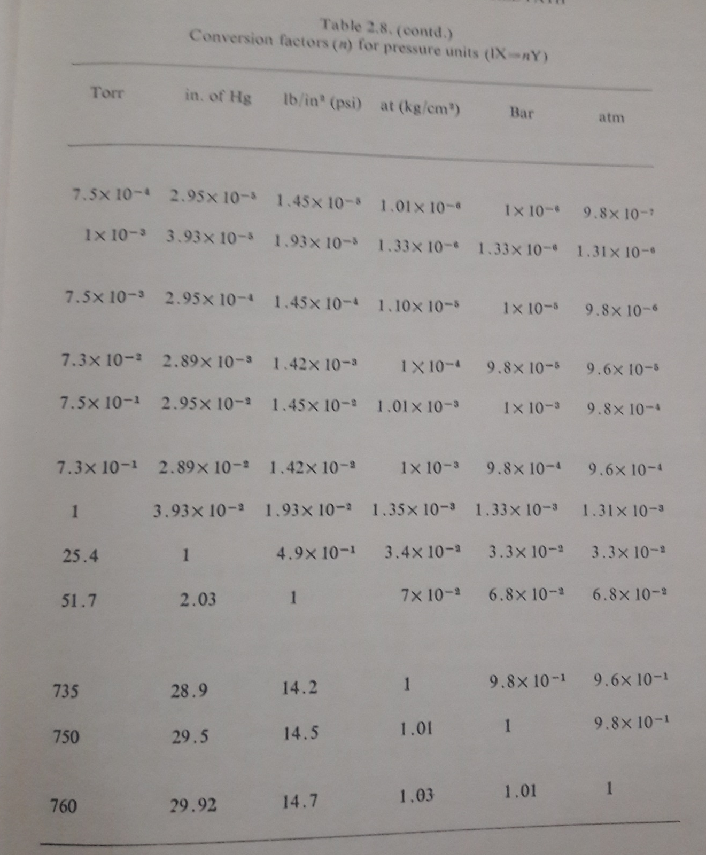

Slide 36
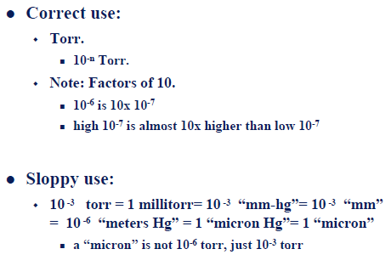

Slide 37
McLeod Gauge

Slide 38
PREVIOUS CLASSES
1- Error analysis
2- Precession, Resolution etc.
3- Examples of different applications of Vacuum Techniques
4- Units of Pressure and its conversions
5- Basics of Gas Properties
6- Gas laws
7- Velocity of gasses etc.
Question: Modify the design of McLeod gauge for the better resolution of pressure measurement
Molecular incident rate, Mean free path and Viscosity of a gas

